Slide 1
Computer Graphics
Day IV

Slide 2
Manipulating 3D Space using 4x4 Matrices
As we have seen, 3x3 matrices are very effective at rotating or scaling our vector data about the origin fully in 3 dimensions.
However, they do not contain the information required to move our vector data away from the origin. (An extra XYZ offset vector for Translation)
Though we could technically get away with a 3x4 matrix, it would be non-square and could never be an identity or orthogonal matrix. (It would also Transpose to a 4x3)
We will also need a 4x4 matrix to do perspective (discussed later) so we might as well be consistent and use a square matrix for both.
Since the 4x4 matrix can perform all the operations a 3x3 matrix can, we will cover all cases.

Slide 3
Review: 4x4 Matrix Attributes
Identity
[
1, 0, 0, 0,
0, 1, 0, 0,
0, 0, 1, 0,
0, 0, 0, 1,
]
Translation
[
1, 0, 0, 0,
0, 1, 0, 0,
0, 0, 1, 0,
x, y, z, 1,
]
Scaling
[
2, 0, 0, 0,
0, 2, 0, 0,
0, 0, 2, 0,
0, 0, 0, 1,
]
Y Rotation
[
cosθ, 0, sinθ, 0,
0, 1, 0, 0,
-sinθ, 0, cosθ, 0,
0, 0, 0, 1,
]
Combined & Decomposed
[
Xx, Xy, Xz, 0,
Yx, Yy, Yz, 0,
Zx, Zy, Zz, 0,
Tx, Ty, Tz, 1,
]
Orientation & Scaling
X Axis Vector3
Y Axis Vector3
Z Axis Vector3
Translation Vector3

Slide 4
The Concept of “Spaces”
Space is often defined by the number of dimensions it contains and what relationships it was created to describe. (Ex: 2D Texture Space, 3D Eye Space)
The “Origin” is the central reference point that all items in a space agree upon as Zero * N.
You have already worked in “2D Screen Space” using pixels directly.
You have also used a normalized 3D coordinate system to represent the screen in a general way before pixel conversion. (Rasterization)
This space is known as “Normalized Device Coordinates”. (NDC Space)
What follows are some common ways to use this same orthogonal 3D space to define spatial relationships when interpreting vertex data.

Slide 5
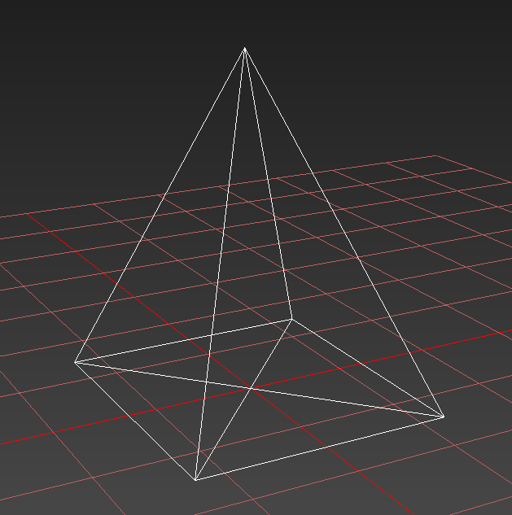
3D Local Space
A.K.A Object or Model Space, this space describes the untransformed vector data that defines our geometric shapes.
The space defines the relationship of vertices to one another and their shared relationship to the origin and its axis set.
A collection of geometric primitives used to describe a single complex shape is call a “Mesh”.
Multiple meshes may comprise a single 3D model. In advanced applications each mesh may exist as part of a larger spatial hierarchy.

Slide 6
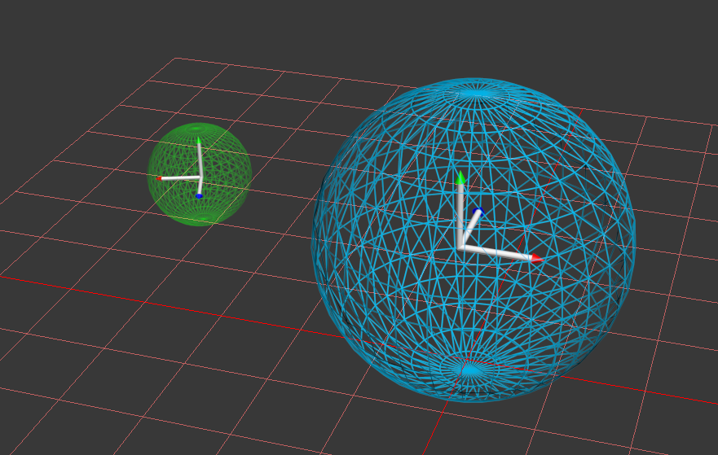
3D Global Space
A.K.A Parent Space, not to be confused with “World Space” which we will describe next.
This space defines another space that contains the current space.
For example: Your fingers could be considered to fall within the global space of your hand.
When walking on a ship, your movements are relative to that ship. The ship’s local space is your global space.
This concept (Matrix Hierarchy) becomes especially important when working with more complex systems.

Slide 7
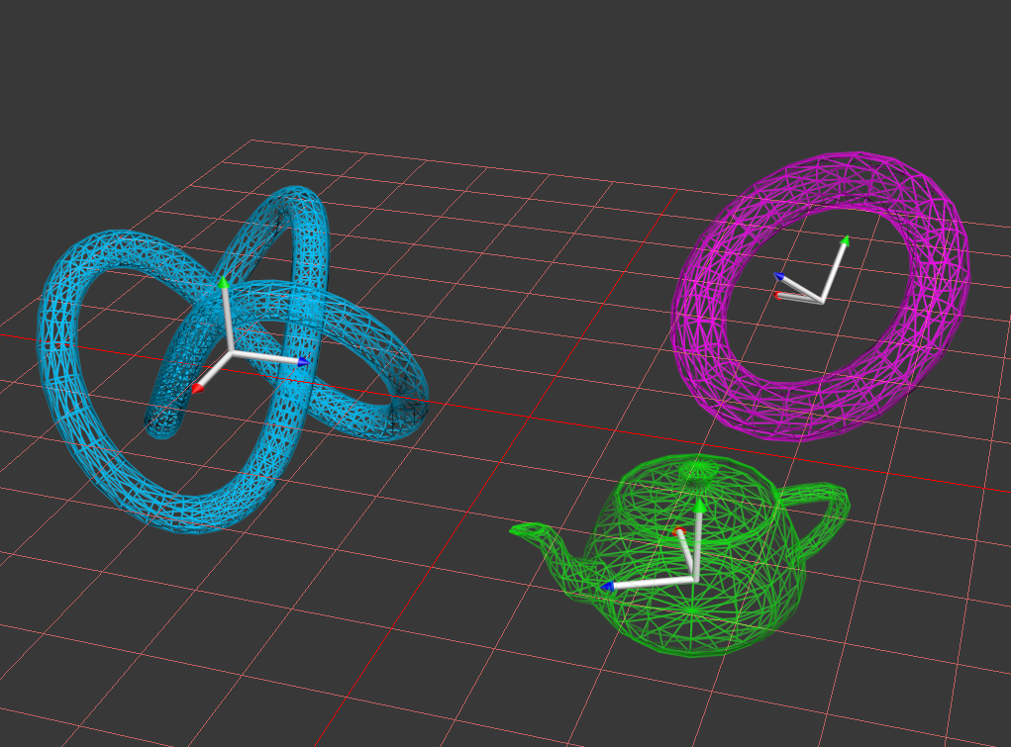
3D World Space
Defines the space where 3D objects are relative to one another.
Typically used to describe the relationships of entire models to one another.
A matrix used to move a model away from its collective starting space is often referred to as a “World Matrix”.
For simple models with no mesh hierarchy, World Space and Global Space are often one and the same.

Slide 8
Matrix Operations: Local Vs. Global
Earlier we reviewed how our 4x4 matrices each contained a set of vectors describing the orientation of that matrix.
These vectors actually represent the “Local Axis” of a matrix IN the “Global” space!
Likewise the translation vector represents the origin of the sub-space.
When a matrix is at “Identity”, its local space is aligned to its global space.
Rotation, Translation and Scaling operations can happen in the space of your choice!
Remember this: Whenever you multiply one matrix by another, the first matrix enters the space of the second matrix. (A * B = C Where C is A moved into B’s Space)

Slide 9
Example: Local Vs. Global Rotation

Slide 10
The Concept of “Viewing” the 3D Scene
The raster is a fixed rectangular grid of pixels. Even if you pick-up and physically move your display it will continue to show the same thing.
At least without intervention from a programmer using an accelerometer.
This means that we must choose what we want to Rasterize on this surface from our 3D environment. (Just like you had to do in 2D)
If our raster cannot move, and NDC Space is limited to the screen… How do we ever see things that may lie outside of the -1 to +1 space?
The Answer: If we cannot move the eye (the screen) then lets move the world instead so that the part we want to see is moved within that range! (Shift World Space)
Example: If I want to shift my point of view to left -3 units and look up 30 degrees. I can achieve the same effect by shifting World space 3 units to the right and rotating -30 degrees on the X axis.

Slide 11
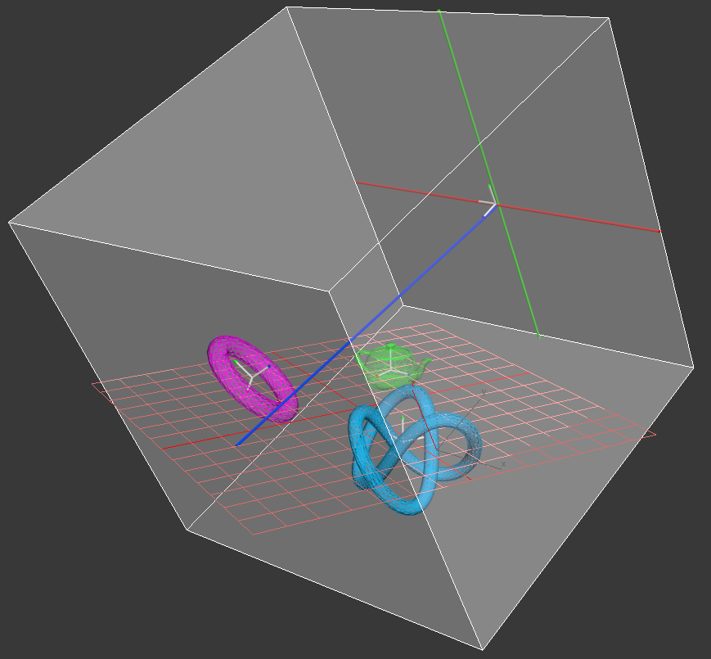
3D View Space
A.K.A Camera or Eye Space.
The Space relative to a world matrix chosen to be the “View Point” of the 3D Scene.
The View Matrix must move every other object to be relative to this position & orientation.
By doing this the chosen world matrix becomes the “New Origin” and things directly in front of it are now on screen. (-1 to +1)

Slide 12
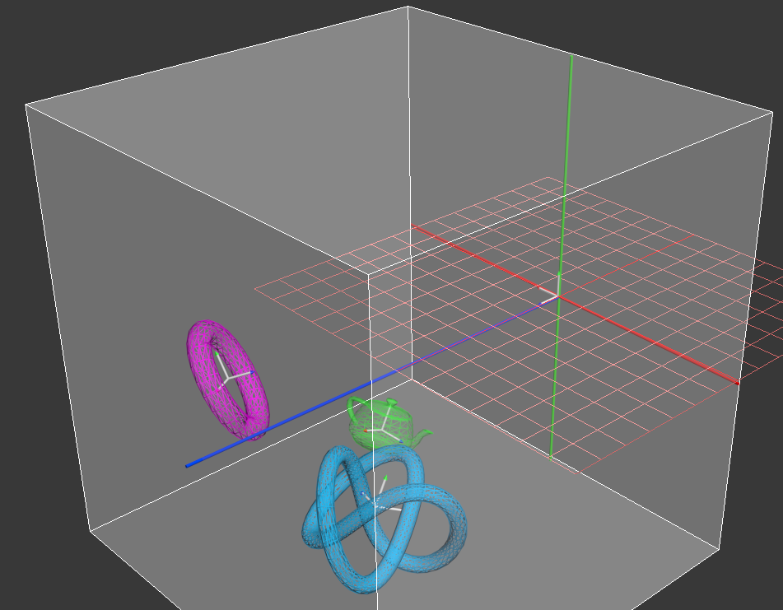
Building a View Matrix
INVERSE MATRIX
This is actually a fairly straight forward process.
Step 1: Create a world matrix with the position and orientation down the +Z axis that you wish to represent your “eye” in this space.
Step 2: Take the mathematical inverse of this matrix. This is will be your “View Matrix”.
Step 3: Use your vertex shader to transform ALL world space vertex data into “View Space”.
Step 4: To move your “camera” simply adjust the matrix from Step 1.

Slide 13
Fast Inverse: Orthogonal Affine 4x4 Matrix
Getting the inverse of a matrix can be a fairly involved process that requires calculating the determinant of said matrix.
It you know for sure that your 4x4 matrix is Affine and Orthogonal there is a short cut that works for this special case:
Step 1: Take the 3x3 portion of the matrix and Transpose it. (swap row & col)
Step 2: Take your position vector and multiply it by the above 3x3 matrix.
Step 3: Take the resulting vector, negate it and overwrite the old position.

Slide 14

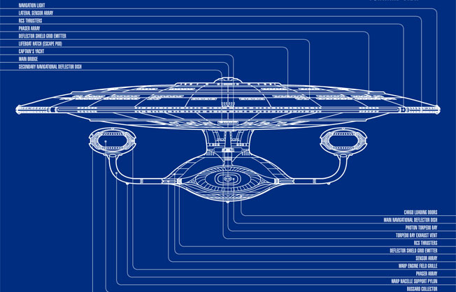
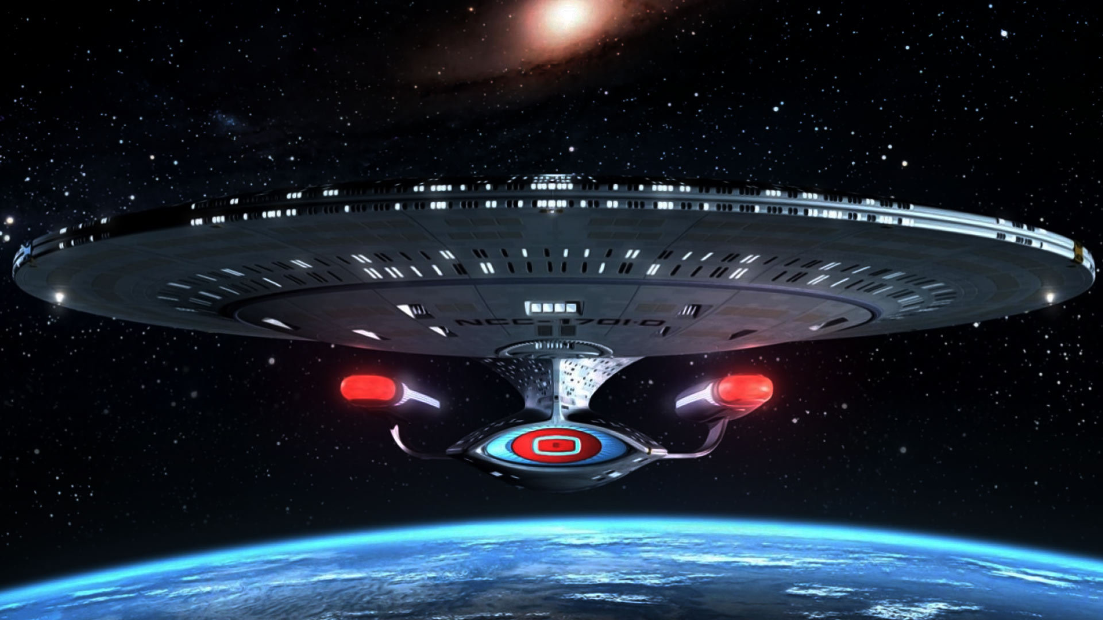
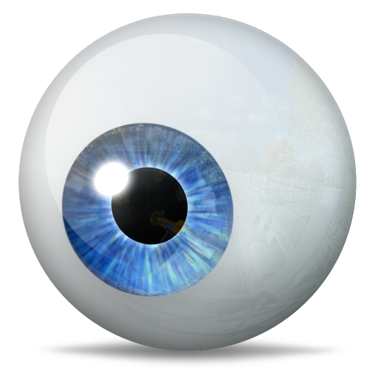
Concept of Projection
Everything you have drawn so far has been done using an “orthographic” projection.
An orthographic projection is affine and preserves all parallel lines.
A “Blue Print” is an example of an orthographic projection. (An enormous flat lens)
Humans do not perceive 3D space in this way. (Instead we use a pair of small curved lenses)
To simulate a “perspective” projection we must somehow “compress” distant visual information so it fits within our view. (NDC Space)

Slide 15



Adding Perspective: Dividing by Z
D
z
ys = y
D
Z axis

Slide 16
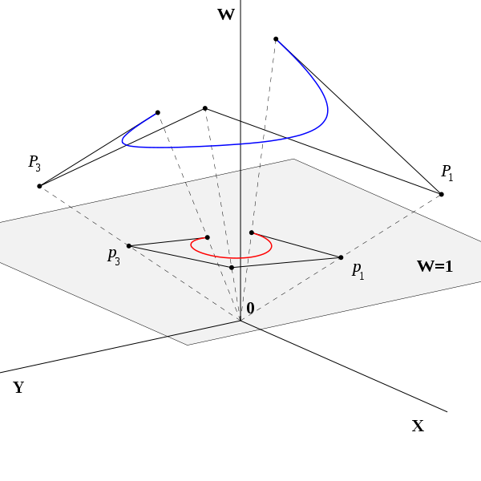
3D Homogenous Projection Space
Barycentric coordinates are an example of a homogenous coordinate system. They can represent the same point on an infinite number of triangles.
Homogenous 3D coordinates (XYZW) can be used to represent a 3D Cartesian point at ANY scale.
When the W component of this space is 1 it intersects normal 3D Cartesian space. (Normalized)
This property enables us to embed perspective scaling information into our standard 3D coordinates.

Slide 17
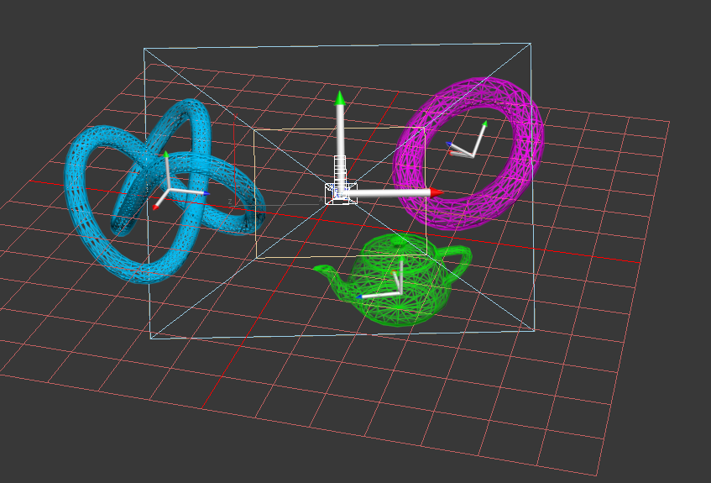
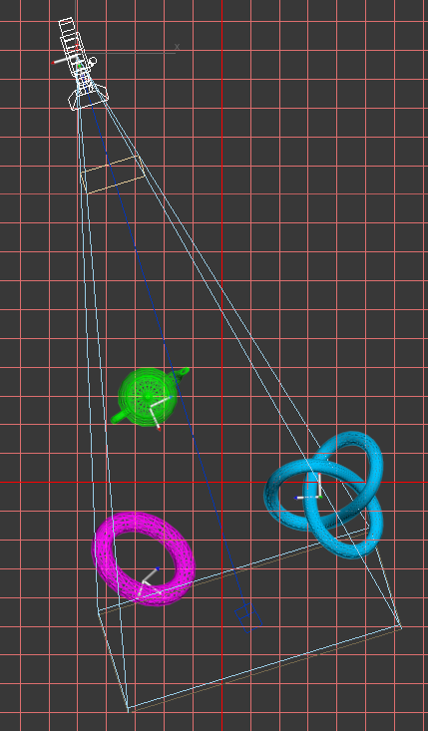
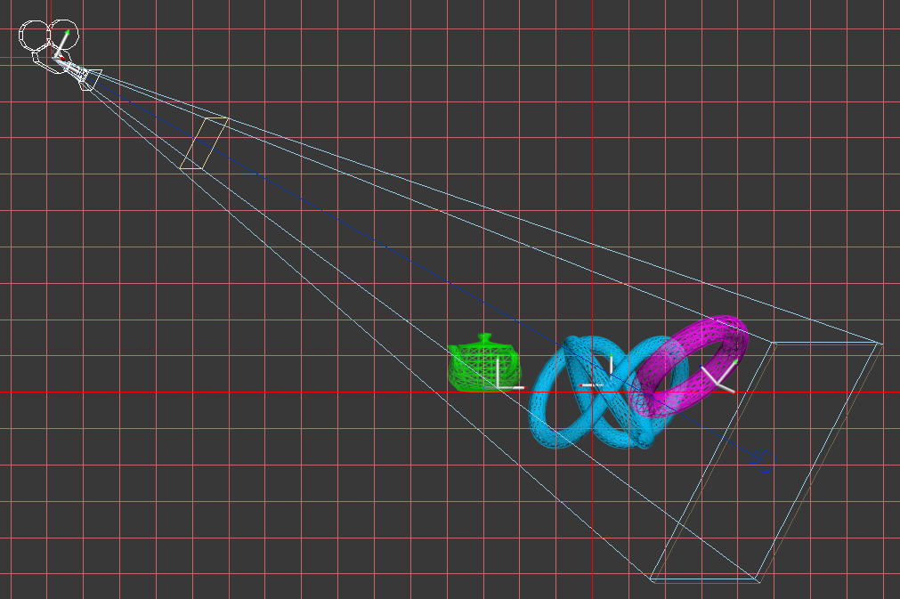
The View Frustum
A pyramid that describes the perspective projection matrix.
It is composed of four primary attributes that define it:
Field of View
Near Plane
Far Plane
Aspect Ratio
These attributes will impact how the vertex information should be scaled to adjust for viewing distance & screen width.

Slide 18
Building a Perspective Projection Matrix
PerspectiveProjection
[
XScale, 0, 0, 0,
0, YScale, 0, 0,
0, 0, zFar / ( zFar – zNear ), 1,
0, 0, -( zFar * zNear ) / ( zFar – zNear ), 0,
]
Yscale = cotangent ( ½ Vertical FOV )
zNear = Near Plane where near != 0
Xscale = Yscale * Aspect Ratio
zFar = Far Plane where far > near

Slide 19
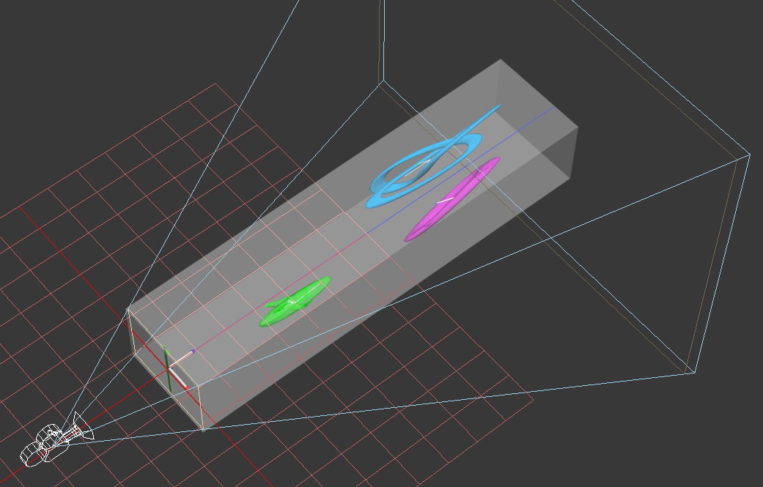
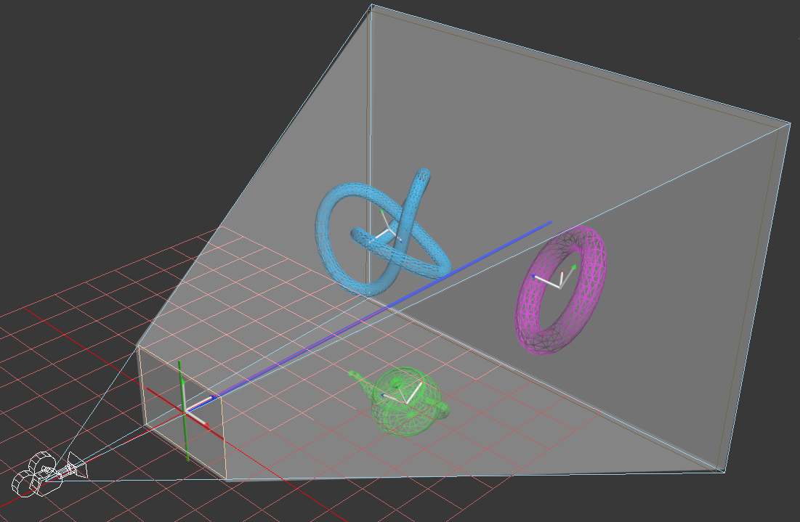
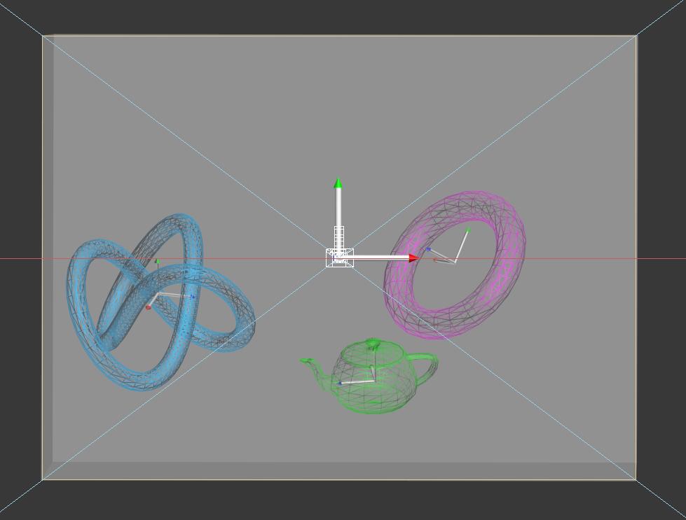
The Perspective Divide
A key part of the Projection Matrix is that it preserves the value of Z in the resulting W component.
Recall that dividing by the Z is what actually creates our perspective.
Since the Projection matrix has handily already scaled our Z coordinates to start at the Near Plane, we need only divide our scaled XYZ by the original Z (now W) to correct for perspective.
XYZ / W
XYZ / W

Slide 20
For Lab: Recap

Slide 21
Applicable Reading Assignment
For next time read:
In Chapter 8 The Graphics Pipeline:
Read section 8.2
In Chapter 11 Texture Mapping
Read sections 11.1 – 11.2
In Chapter 12 Data Structures for Graphics:
Read section 12.1

